Slide 1




Football
FIFA World Cup Analytics

Slide 2

Presented BY
Mohamed Amin
Ahmed Sayed
Youssef Ahmed
Abdelrahman Mostafa
Presented To
ENG Farah Abdou

Slide 3

Outline
Matches by Tournament
Player Distribution by Position
Match Results Distribution
Goals by Match Minute
Most Common Match Scores
Own Goals by Country
Bookings by Match Period
Highest Winning Margin in World Cup History
Penalty Shootout Wins by Team
Picture of dash board
The end

Slide 4
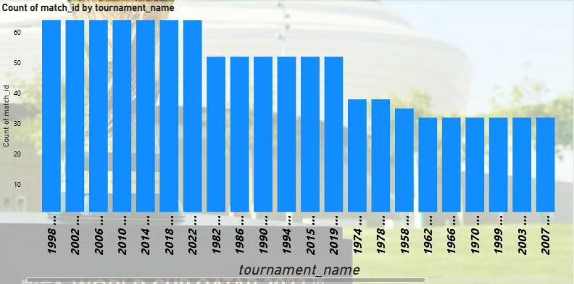
Matches by Tournament
Summary:
Shows the number of matches played in each FIFA World Cup edition.
Key Insight:
Recent tournaments include more matches than earlier editions due to the expansion of the competition format.
Why It Matters:
Provides historical context for comparing tournaments and understanding how changes in format affect overall competition statistics.

Slide 5
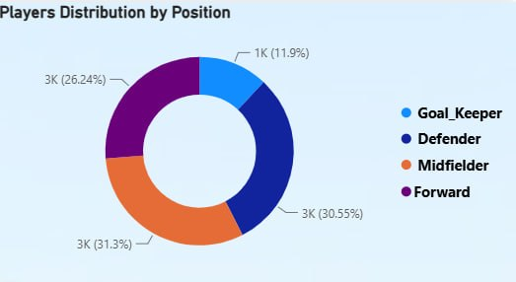
Player Distribution by Position
Summary:
Illustrates the distribution of players across the four main playing positions.
Key Insight:
Defenders and midfielders represent the largest share of players, while goalkeepers account for the smallest proportion.
Why It Matters:
Highlights squad composition and positional balance, supporting tactical and player development analysis.

Slide 6
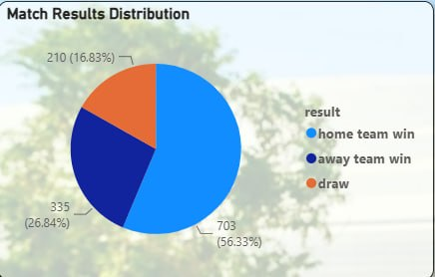
Match Results Distribution
Summary:
Displays the distribution of match outcomes between home wins, away wins, and draws.
Key Insight:
Home teams account for the highest percentage of victories, while draws represent the smallest share of results.
Why It Matters:
Provides insight into home-field advantage and overall competitiveness in World Cup matches.

Slide 7
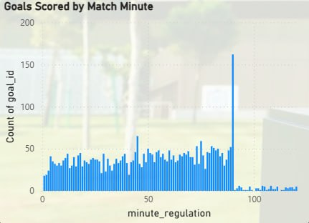
Goals by Match Minute
Summary:
Shows how goals are distributed across different match minutes throughout the game.
Key Insight:
Goal scoring increases in the later stages of matches, with a significant peak around the 90th minute.
Why It Matters:
Helps coaches and analysts understand scoring patterns, optimize substitutions, and improve late-game strategies.

Slide 8
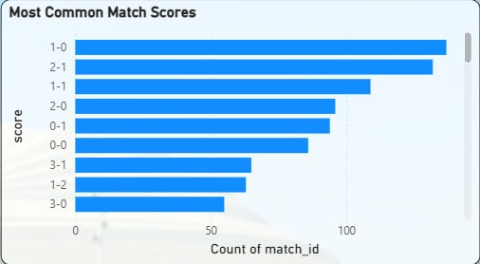
Most Frequent Match Scorelines
Summary:
Displays the most frequently occurring final scorelines across all FIFA World Cup matches.
Why It Matters:
Identifies common match outcomes and helps understand scoring trends, match competitiveness, and historical result patterns.
Key Insight:
The 1–0 scoreline is the most frequent result, closely followed by 2–1, indicating that low-scoring matches are the most common in World Cup history.

Slide 9
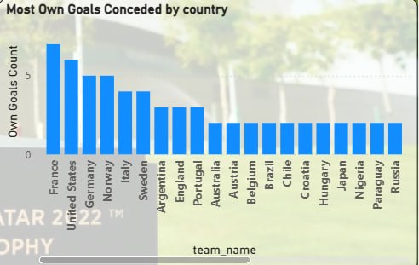
Countries with the Most Own Goals
Summary:
Shows which national teams have conceded the highest number of own goals throughout FIFA World Cup history.
Why It Matters:
Own goals are rare but can significantly influence match outcomes. Identifying affected teams helps analyze defensive performance and high-pressure situations.
Key Insight:
France records the highest number of own goals conceded in the dataset, followed by the United States and Germany.

Slide 10
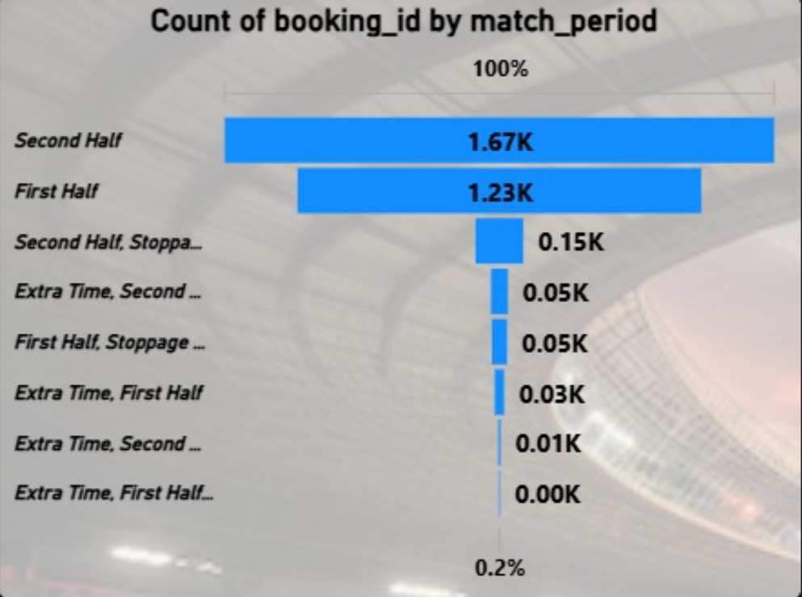
Bookings by Match Period
Summary:
Displays the distribution of yellow and red card bookings across different match periods, including regular time, stoppage time, and extra time.
Why It Matters:
Helps identify when disciplinary actions occur most frequently, providing insights into player behavior, match intensity, and fatigue throughout the game.
Key Insight:
The Second Half records the highest number of bookings, followed by the First Half, while extra time and stoppage time contribute only a small share of total bookings. This suggests that player fatigue and increased match intensity lead to more fouls in the later stages of regular play.

Slide 11
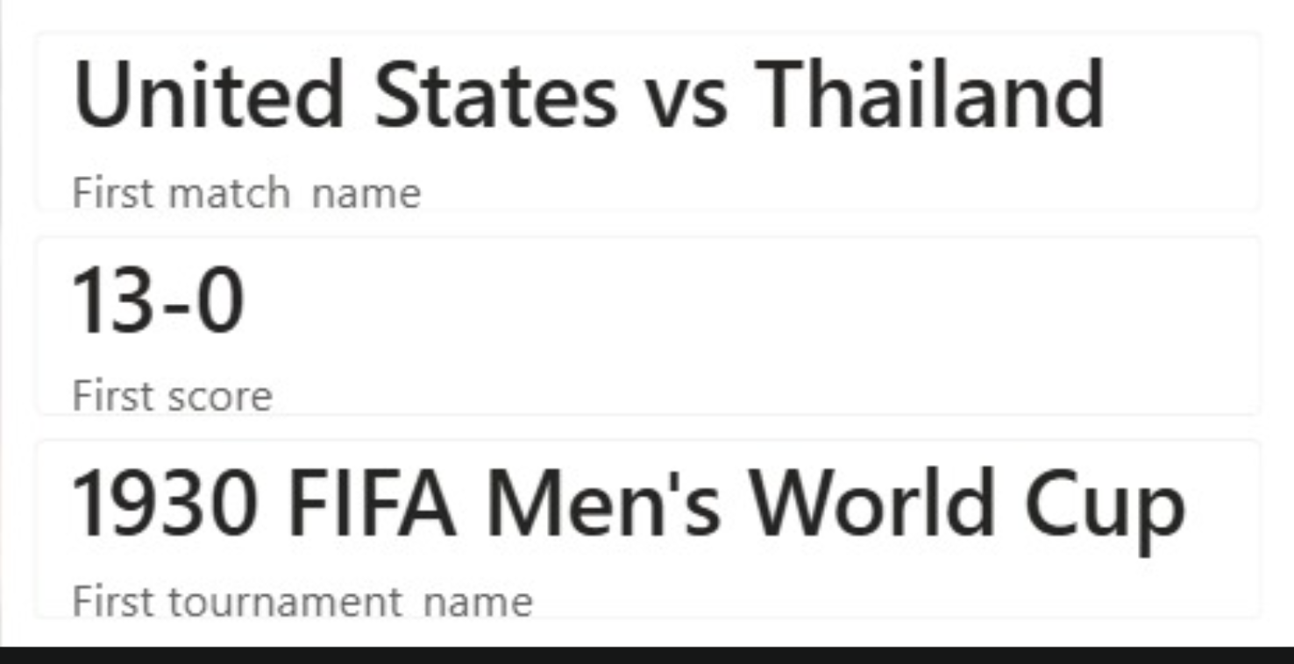
Highest Winning Margin in World Cup History
Summary
Highlights the match with the largest goal difference in FIFA World Cup history, including the teams, final score, and tournament edition.
Why It Matters
Identifies the most dominant performance ever recorded in the tournament and showcases one of the World Cup's most memorable historical records.
Key Insight
The United States defeated Thailand 13–0, setting the largest winning margin in FIFA World Cup history. This record reflects an exceptional offensive performance and remains one of the tournament's most remarkable achievements.

Slide 12
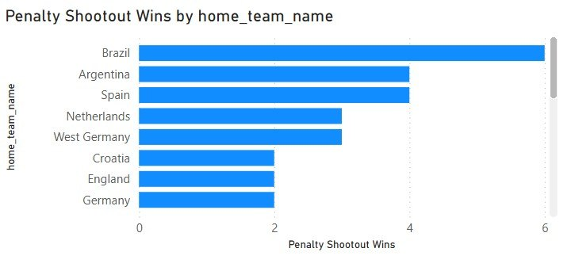
Penalty Shootout Wins by Team
Summary:
Ranks national teams based on the number of penalty shootout victories in FIFA World Cup history.
Why It Matters:
Penalty shootouts often decide knockout matches. This analysis highlights teams that consistently perform well under extreme pressure.
Key Insight:
Brazil leads the ranking, while Argentina and Spain also demonstrate strong records in penalty shootouts.

Slide 13
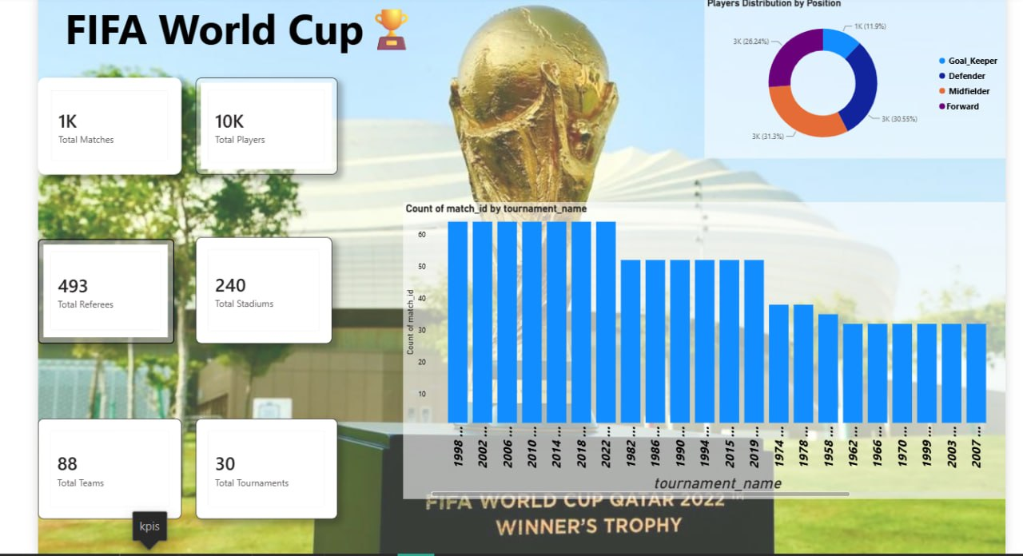
Picture of dash board

Slide 14
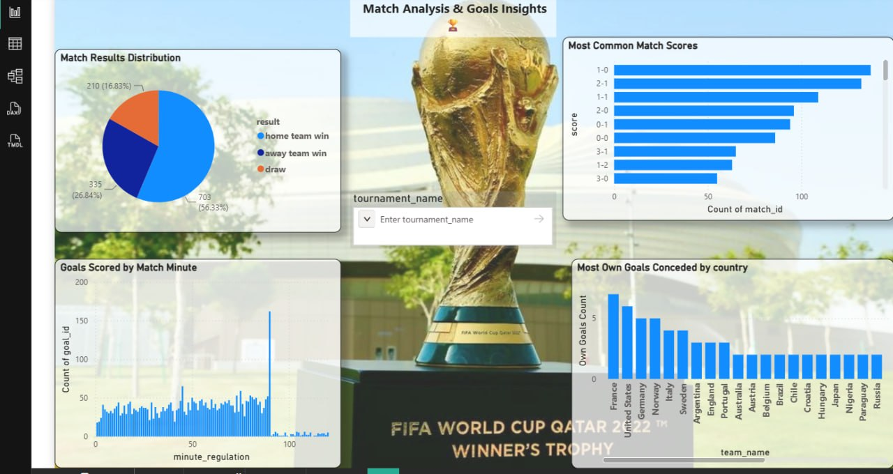
Picture of dash board

Slide 15
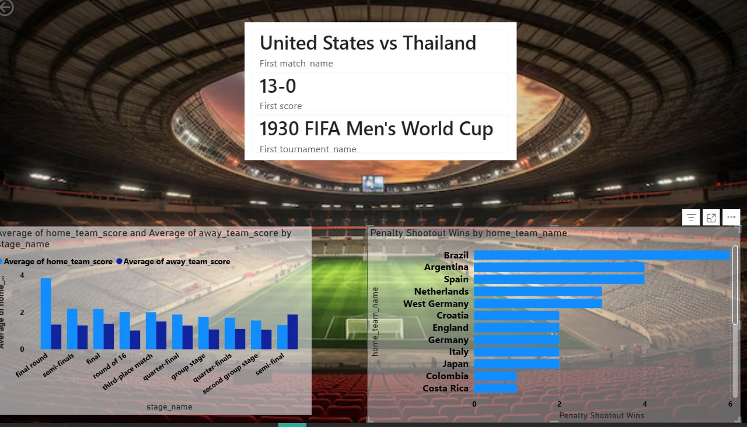
Picture of dash board

Slide 16
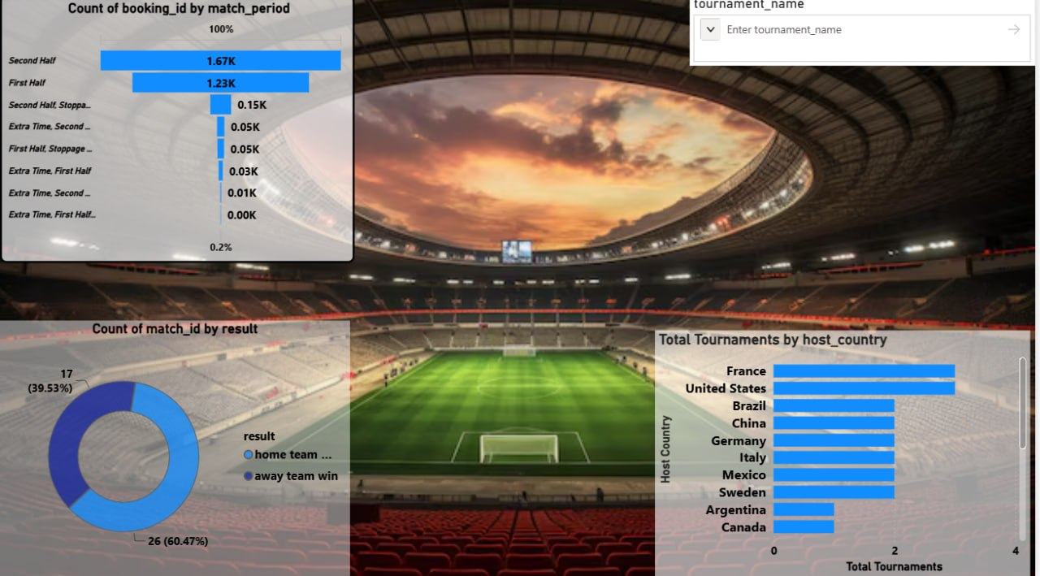
Picture of dash board

Slide 17
Thank you

